Slide 1
Cayley Hamilton Theorem
Caley Hamilton Theorem states that
“Every square matrix satisfies its own characteristic equation”.

Slide 2

Q.1.Verify Cayley Hamilton Theorem for the matrix $A=\left[\begin{matrix}1 & 4 \\ 2 & 3\end{matrix}\right]$ and find its inverse. Also express $A^{5}−{4A}^{4}−7A^{3}+11A^{2}−A−10I$ as linear polynomial in A.
Solution:
Cayley Hamilton Theorem:Every square matrix satisfies its own characteristics equation.
We have to verify the Cayley Hamilton Theorem for the matrix $A=\left[\begin{matrix}1 & 4 \\ 2 & 3\end{matrix}\right]$
Characteristics equation of A is given by
$\left|A−λI\right|=0$or$λ^{2}−S_{1}λ+\left|A\right|=0$ - - - - - - - - (1)
where $S_{1}$$=$ Sum of diagonal elements $=$$1+3=4$
$\left|A\right|$$=$$\left|\begin{matrix}1 & 4 \\ 2 & 3\end{matrix}\right|=1×3−4×2=3−8=−5$
So (1) becomes
$λ^{2}−4λ−5=0$ - - - - - - - - (2)
This is characteristic equation of the given matrix A.
Hence by the Cayley Hamilton Theorem
$A^{2}−4A−5I=0$ - - - - - - - - (3)
Now, we have to verify the Cayley Hamilton Theorem for the given matrix A.

Slide 3

Let us compute
$A^{2}$$=$$A×A$
$=$$\left[\begin{matrix}1 & 4 \\ 2 & 3\end{matrix}\right]×\left[\begin{matrix}1 & 4 \\ 2 & 3\end{matrix}\right]$
$=$$\left[\begin{matrix}1×1+4×2 & 1×4+4×3 \\ 2×1+3×2 & 2×4+3×3\end{matrix}\right]=\left[\begin{matrix}9 & 16 \\ 8 & 17\end{matrix}\right]$
Now consider
L.H.S.$=$$A^{2}−4A−5I$
$=$$\left[\begin{matrix}9 & 16 \\ 8 & 17\end{matrix}\right]−4\left[\begin{matrix}1 & 4 \\ 2 & 3\end{matrix}\right]−5\left[\begin{matrix}1 & 0 \\ 0 & 1\end{matrix}\right]$
$=$$\left[\begin{matrix}9 & 16 \\ 8 & 17\end{matrix}\right]−\left[\begin{matrix}4 & 16 \\ 8 & 12\end{matrix}\right]−\left[\begin{matrix}5 & 0 \\ 0 & 1\end{matrix}\right]$
$=$$\left[\begin{matrix}9−4−5 & 16−16−0 \\ 8−8−0 & 17−12−5\end{matrix}\right]$
$=$$\left[\begin{matrix}0 & 0 \\ 0 & 0\end{matrix}\right]=0=$ R. H. S.
$∴$$\boxed{A^{2}−4A−5I=0}$
Hence Cayley Hamilton Theorem is verified.
5

Slide 4

We have to calculate $A^{−1}$.
Since $\left|A\right|=−5≠0$, so $A^{−1}$exists. Now operating $A^{−1}$on both the sides of (3), we have
$A^{−1} (A^{2}−4A−5I)=A^{−1}(0)$
$⇒$${(A}^{−1}A)A−4{(A}^{−1}A)−5A^{−1}=0$$\left[∵A^{−1}A=I\right]$
$⇒$$IA−4I−5A^{−1}=0$
$⇒$$−5A^{−1}=−A+4I$$\left[∵A=\left[\begin{matrix}1 & 4 \\ 2 & 3\end{matrix}\right]\right]$
$⇒$$A^{−1}$$=$$\frac{1}{5}\left[A−4I\right]$
$=$$\frac{1}{5}\left\{\left[\begin{matrix}1 & 4 \\ 2 & 3\end{matrix}\right]−4\left[\begin{matrix}1 & 0 \\ 0 & 1\end{matrix}\right]\right\}$
$=$$\frac{1}{5}\left\{\left[\begin{matrix}1 & 4 \\ 2 & 3\end{matrix}\right]−\left[\begin{matrix}4 & 0 \\ 0 & 4\end{matrix}\right]\right\}$
$=$$\frac{1}{5}\left[\begin{matrix}1−4 & 4−0 \\ 2−0 & 3−4\end{matrix}\right]$
$=$$\frac{1}{5}\left[\begin{matrix}−3 & 4 \\ 2 & −1\end{matrix}\right]$
$∴$$\boxed{A^{−1}=\frac{1}{5}\left[\begin{matrix}−3 & 4 \\ 2 & −1\end{matrix}\right]}$

Slide 5
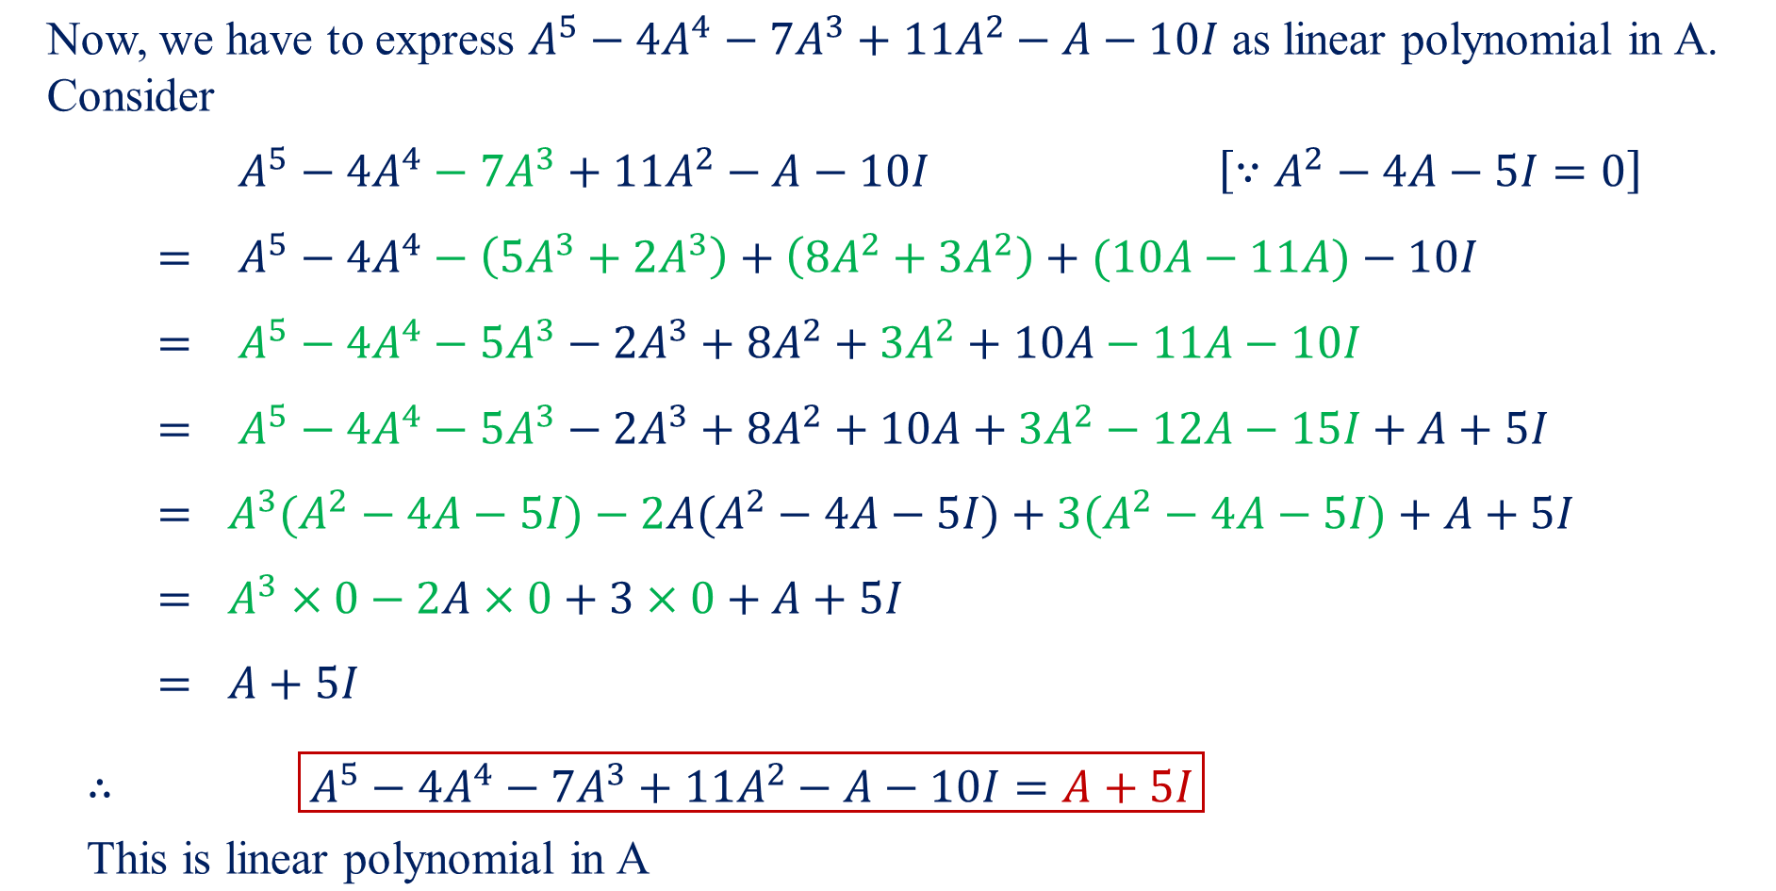

Slide 6
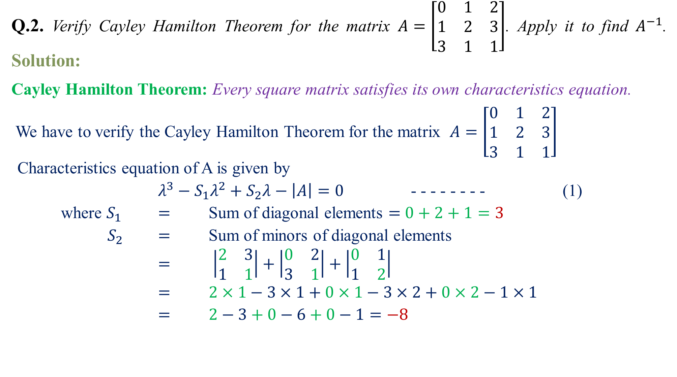
Q.2.Verify Cayley Hamilton Theorem for the matrix $A=\left[\begin{matrix}0 & 1 & 2 \\ 1 & 2 & 3 \\ 3 & 1 & 1\end{matrix}\right]$. Apply it to find $A^{−1}$. Solution:
Cayley Hamilton Theorem:Every square matrix satisfies its own characteristics equation.
We have to verify the Cayley Hamilton Theorem for the matrix $A=\left[\begin{matrix}0 & 1 & 2 \\ 1 & 2 & 3 \\ 3 & 1 & 1\end{matrix}\right]$
Characteristics equation of A is given by
$λ^{3}−S_{1}λ^{2}+S_{2}λ−\left|A\right|=0$ - - - - - - - - (1)
where $S_{1}$$=$ Sum of diagonal elements $=$$0+2+1=3$
$S_{2}$$=$ Sum of minors of diagonal elements
$=$$\left|\begin{matrix}2 & 3 \\ 1 & 1\end{matrix}\right|+\left|\begin{matrix}0 & 2 \\ 3 & 1\end{matrix}\right|+\left|\begin{matrix}0 & 1 \\ 1 & 2\end{matrix}\right|$
$=$$2×1−3×1+0×1−3×2+0×2−1×1$
$=$$2−3+0−6+0−1=−8$

Slide 7
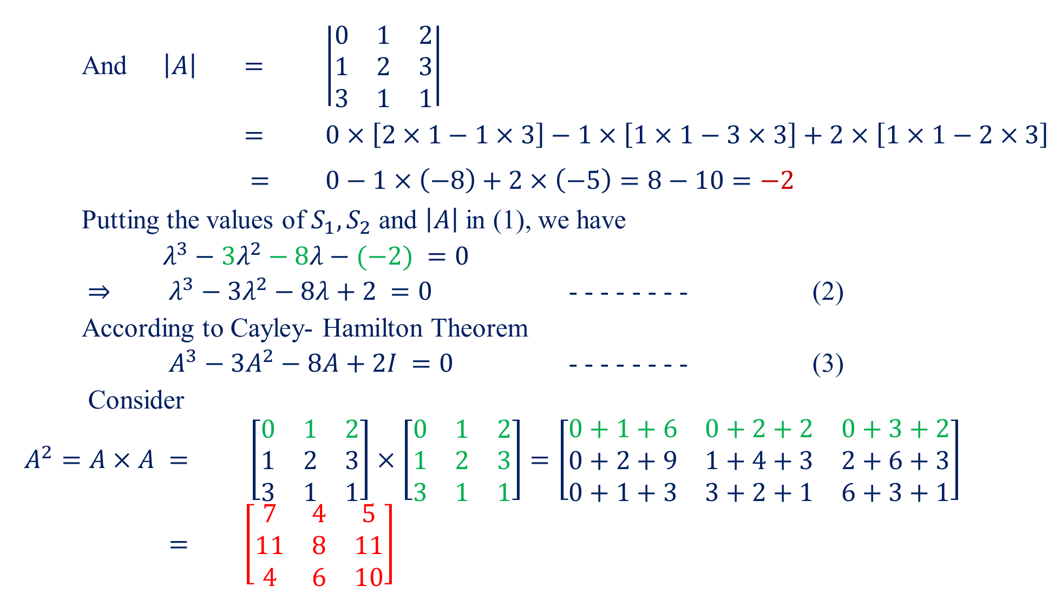
And $\left|A\right|$$=$$\left|\begin{matrix}0 & 1 & 2 \\ 1 & 2 & 3 \\ 3 & 1 & 1\end{matrix}\right|$
$=$$0×\left[2×1−1×3\right]−1×\left[1×1−3×3\right]+2×\left[1×1−2×3\right]$
$=$$0−1×\left(−8\right)+2×\left(−5\right)=8−10=−2$
Putting the values of $S_{1},S_{2}$ and $\left|A\right|$in (1), we have
$λ^{3}−3λ^{2}−8λ−(−2) =0$
$⇒$$λ^{3}−3λ^{2}−8λ+2 =0$ - - - - - - - - (2)
According to Cayley- Hamilton Theorem
$A^{3}−3A^{2}−8A+2I =0$ - - - - - - - - (3)
Consider
$A^{2}=A×A$$=$$\left[\begin{matrix}0 & 1 & 2 \\ 1 & 2 & 3 \\ 3 & 1 & 1\end{matrix}\right]×\left[\begin{matrix}0 & 1 & 2 \\ 1 & 2 & 3 \\ 3 & 1 & 1\end{matrix}\right]=\left[\begin{matrix}0+1+6 & 0+2+2 & 0+3+2 \\ 0+2+9 & 1+4+3 & 2+6+3 \\ 0+1+3 & 3+2+1 & 6+3+1\end{matrix}\right]$
$=$$\left[\begin{matrix}7 & 4 & 5 \\ 11 & 8 & 11 \\ 4 & 6 & 10\end{matrix}\right]$

Slide 8
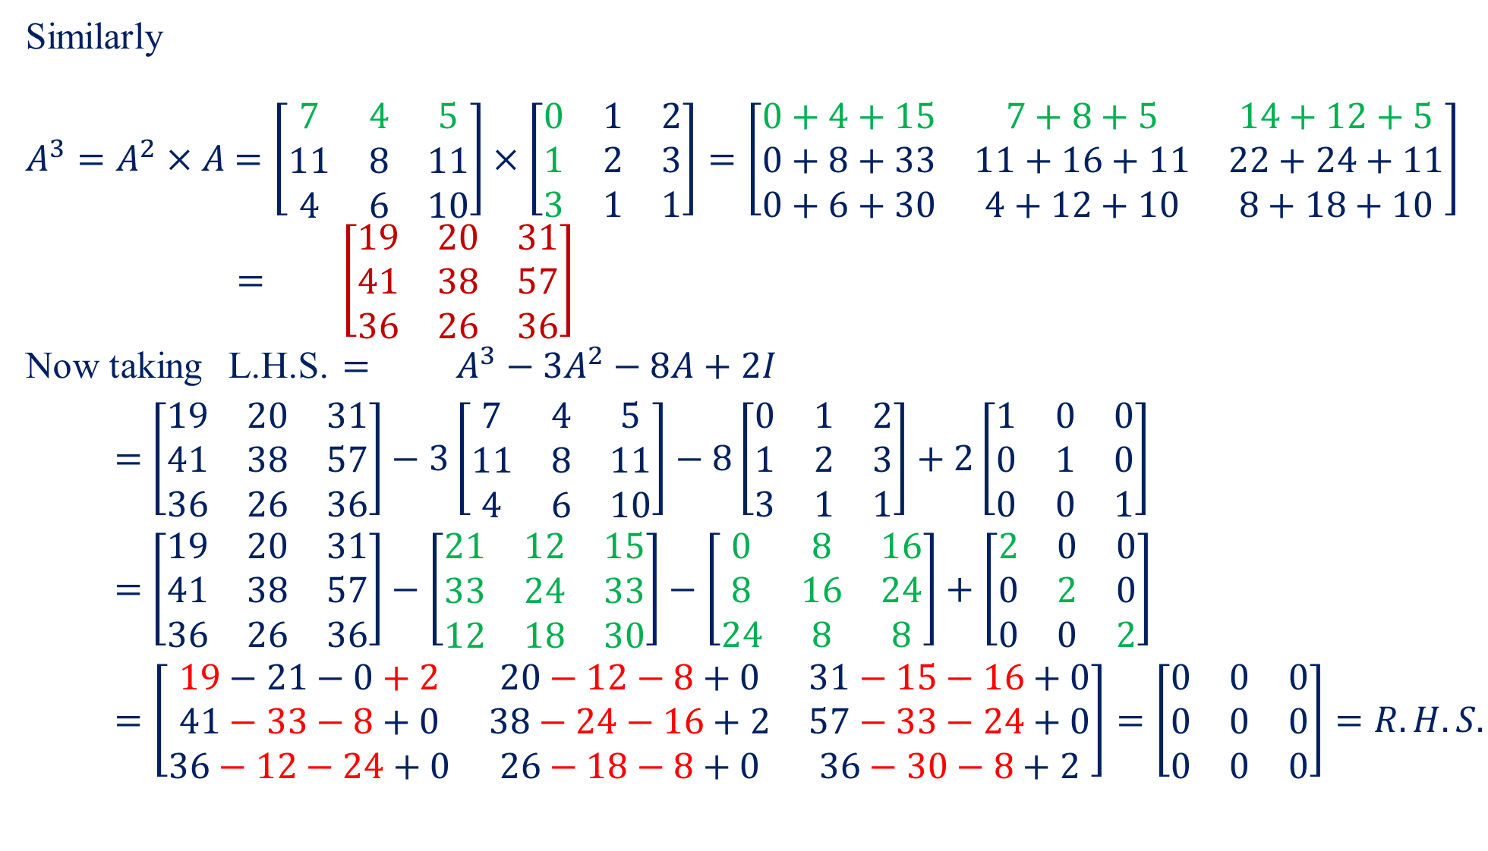
Similarly
$A^{3}=A^{2}×A$$=\left[\begin{matrix}7 & 4 & 5 \\ 11 & 8 & 11 \\ 4 & 6 & 10\end{matrix}\right]×\left[\begin{matrix}0 & 1 & 2 \\ 1 & 2 & 3 \\ 3 & 1 & 1\end{matrix}\right]=\left[\begin{matrix}0+4+15 & 7+8+5 & 14+12+5 \\ 0+8+33 & 11+16+11 & 22+24+11 \\ 0+6+30 & 4+12+10 & 8+18+10\end{matrix}\right]$
$=$$\left[\begin{matrix}19 & 20 & 31 \\ 41 & 38 & 57 \\ 36 & 26 & 36\end{matrix}\right]$
Now taking L.H.S. $=$$A^{3}−3A^{2}−8A+2I$
$=$$\left[\begin{matrix}19 & 20 & 31 \\ 41 & 38 & 57 \\ 36 & 26 & 36\end{matrix}\right]−3\left[\begin{matrix}7 & 4 & 5 \\ 11 & 8 & 11 \\ 4 & 6 & 10\end{matrix}\right]−8\left[\begin{matrix}0 & 1 & 2 \\ 1 & 2 & 3 \\ 3 & 1 & 1\end{matrix}\right]+2\left[\begin{matrix}1 & 0 & 0 \\ 0 & 1 & 0 \\ 0 & 0 & 1\end{matrix}\right]$
$=$$\left[\begin{matrix}19 & 20 & 31 \\ 41 & 38 & 57 \\ 36 & 26 & 36\end{matrix}\right]−\left[\begin{matrix}21 & 12 & 15 \\ 33 & 24 & 33 \\ 12 & 18 & 30\end{matrix}\right]−\left[\begin{matrix}0 & 8 & 16 \\ 8 & 16 & 24 \\ 24 & 8 & 8\end{matrix}\right]+\left[\begin{matrix}2 & 0 & 0 \\ 0 & 2 & 0 \\ 0 & 0 & 2\end{matrix}\right]$
$=\left[\begin{matrix}19−21−0+2 & 20−12−8+0 & 31−15−16+0 \\ 41−33−8+0 & 38−24−16+2 & 57−33−24+0 \\ 36−12−24+0 & 26−18−8+0 & 36−30−8+2\end{matrix}\right]=\left[\begin{matrix}0 & 0 & 0 \\ 0 & 0 & 0 \\ 0 & 0 & 0\end{matrix}\right]=R.H.S.$

Slide 9
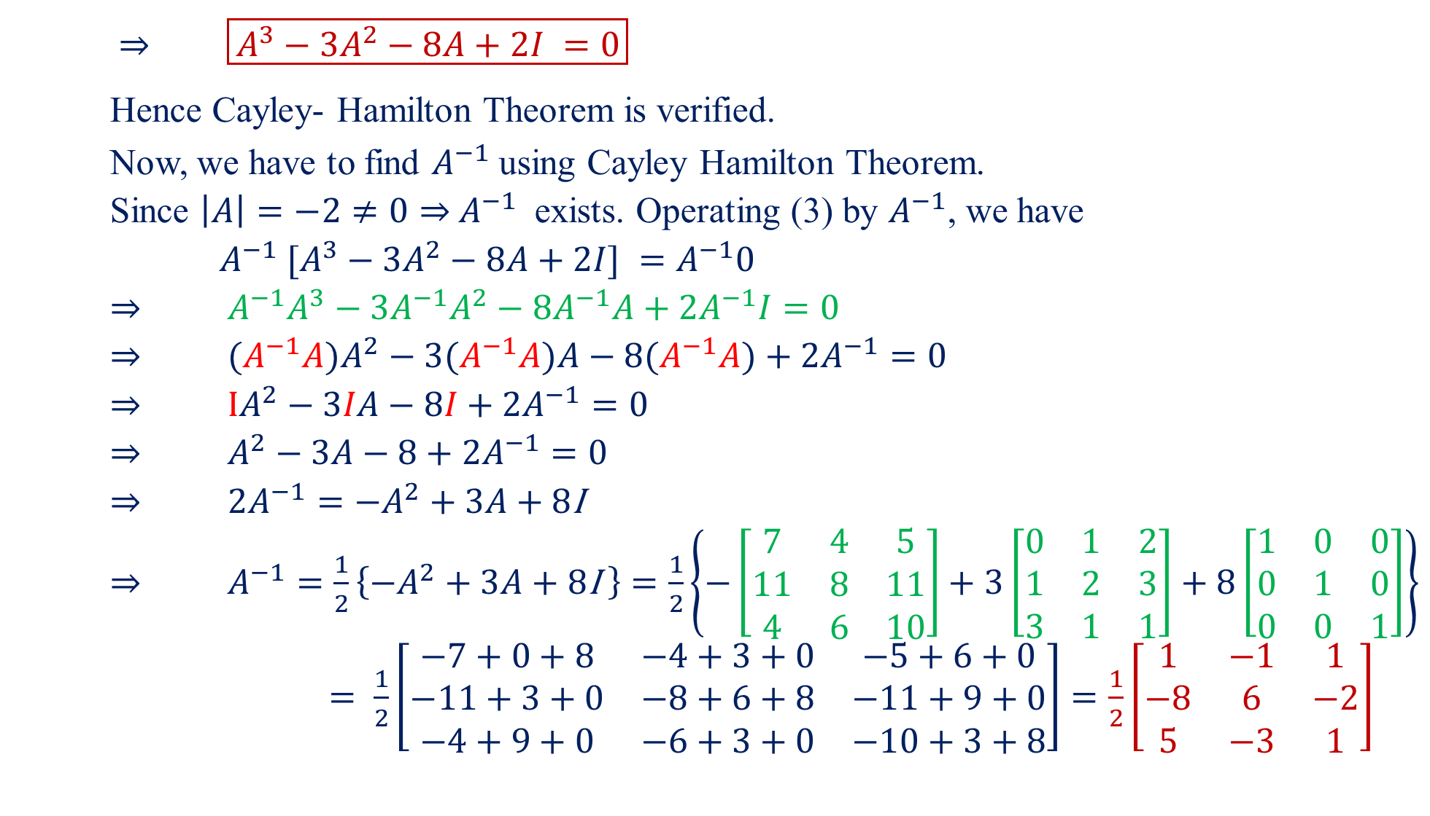
$⇒$$\boxed{A^{3}−3A^{2}−8A+2I =0}$
Hence Cayley- Hamilton Theorem is verified.
Now, we have to find $A^{−1}$using Cayley Hamilton Theorem.
Since $\left|A\right|=−2≠0⇒$$A^{−1}$ exists. Operating (3) by $A^{−1}$, we have
$A^{−1} [A^{3}−3A^{2}−8A+2I] =A^{−1}0$
$⇒$$A^{−1}A^{3}−3A^{−1}A^{2}−8A^{−1}A+2A^{−1}I=0$
$⇒$${(A}^{−1}{A)A}^{2}−3(A^{−1}A)A−8(A^{−1}A)+2A^{−1}=0$
$⇒$$IA^{2}−3IA−8I+2A^{−1}=0$
$⇒$$A^{2}−3A−8+2A^{−1}=0$
$⇒$$2A^{−1}=−A^{2}+3A+8$I
$⇒$$A^{−1}=\frac{1}{2}\left\{−A^{2}+3A+8\text{I} \right\}=\frac{1}{2}\left\{−\left[\begin{matrix}7 & 4 & 5 \\ 11 & 8 & 11 \\ 4 & 6 & 10\end{matrix}\right]+3\left[\begin{matrix}0 & 1 & 2 \\ 1 & 2 & 3 \\ 3 & 1 & 1\end{matrix}\right]+8\left[\begin{matrix}1 & 0 & 0 \\ 0 & 1 & 0 \\ 0 & 0 & 1\end{matrix}\right]\right\}$
$= \frac{1}{2}\left[\begin{matrix}−7+0+8 & −4+3+0 & −5+6+0 \\ −11+3+0 & −8+6+8 & −11+9+0 \\ −4+9+0 & −6+3+0 & −10+3+8\end{matrix}\right]=\frac{1}{2}\left[\begin{matrix}1 & −1 & 1 \\ −8 & 6 & −2 \\ 5 & −3 & 1\end{matrix}\right]$

Slide 10

Home Assignment
Q.1.Verify Cayley Hamilton Theorem for the matrix $A=\left[\begin{matrix}1 & 2 & −2 \\ −1 & 3 & 0 \\ 0 & −2 & 1\end{matrix}\right]$ and use it find $A^{4}$ and $A^{−1}$.
Answer:Characteristic Equation is $λ^{3}−5λ^{2}+9λ−1 =0$,
$A^{4}=\left[\begin{matrix}−55 & 104 & 24 \\ −20 & −15 & 32 \\ 32 & −40 & −23\end{matrix}\right]$$A^{−1}=A^{2}−5A+9I=\left[\begin{matrix}3 & 2 & 6 \\ 1 & 1 & 2 \\ 2 & 2 & 5\end{matrix}\right]$.
Q.2.Verify Cayley Hamilton Theorem for the matrix $A=\left[\begin{matrix}2 & 1 & 1 \\ 0 & 1 & 0 \\ 1 & 1 & 2\end{matrix}\right]$ and use it find the matrix $A^{8}−5A^{7}+7A^{6}−3A^{5}+A^{4}−5A^{3}+8A^{2}−2A+I$.
Answer:Characteristic Equation is $λ^{3}−5λ^{2}+7λ−3 =0$, $A^{2}+A+I$
Q.3.Verify Cayley Hamilton Theorem for the matrix $A=\left[\begin{matrix}2 & −1 & 1 \\ −1 & 2 & −1 \\ 1 & −1 & 2\end{matrix}\right]$ and use it find $A^{−1}$.

Slide 11

Answer:Characteristic Equation is $λ^{3}−6λ^{2}+9λ−4 =0$, $A^{−1}=\frac{1}{4}\left[\begin{matrix}3 & 1 & −1 \\ 1 & 3 & 1 \\ −1 & 1 & 3\end{matrix}\right]$.
Q.4.Verify Cayley Hamilton Theorem for the matrix $A=\left[\begin{matrix}0 & 1 & 2 \\ 1 & 2 & 3 \\ 3 & 1 & 1\end{matrix}\right]$ and use it find $A^{−1}$.
Answer:Characteristic Equation is $λ^{3}−3λ^{2}−8λ+2 =0$, $A^{−1}=\frac{1}{2}\left[\begin{matrix}1 & −1 & 1 \\ −8 & 6 & −2 \\ 5 & −3 & 1\end{matrix}\right]$.
Q.5.Verify Cayley Hamilton Theorem for the matrix $A=\left[\begin{matrix}4 & 6 & 6 \\ 1 & 3 & 2 \\ −1 & −4 & −3\end{matrix}\right]$. Find $A^{−1},A^{−2}$,$A^{−3}$.
Answer:Characteristic Equation is $λ^{3}−4λ^{2}−λ+4 =0$, $A^{−1}=\frac{1}{4}\left[\begin{matrix}1 & 6 & 6 \\ −1 & 6 & 2 \\ 1 & −10 & −6\end{matrix}\right]$, $A^{−2}=\frac{1}{16}\left[\begin{matrix}1 & −18 & −18 \\ −5 & 10 & −6 \\ 5 & 6 & 22\end{matrix}\right]$, $A^{−3}=\frac{1}{64}\left[\begin{matrix}1 & 78 & 78 \\ −21 & 90 & 26 \\ 21 & −154 & −90\end{matrix}\right]$.

